Slide 1

ANALYSIS ON ELECTRIC VEHICLES (EV)

Slide 2
About me :
I am S Deveshwaran . I am currently pursuing my final year in B.Tech in the stream of Artificial Intelligence and Data Science . I’m a results-driven passionate aficionado with a knack for harnessing the power of data and technology to drive organizational success .With foundations in Python and its use in AI and Data Science, Java, and SQL, I thrive on solving problems and developing innovative solutions .A dedicated individual with a culture of innovation and leadership.
LinkedIn Profile : www.linkedin.com/in/deveshwaran-sridharan
Github Profile : https://github.com/Deveshwaran2004

Slide 3
Business Problem :
The problems aims to set up analysis on the Electric Vehicle dataset to understand how the distribution of Electric vehicles is established in different states and cities and counties of the United States of America . Here we are going to understand how the EV have evolved during different years and how different companies have established their supremacy in terms of EV development and deployment and sales.
Objective :
The objective of the project is to provide deep analytical understanding on the dataset by performing EDA (Exploratory Data Analytics) and various types of it to bring out the underlying insights , patterns , relationships between single entities and multiple entities that help us in gaining an understanding about how the EV have gotten into the market . To reveal trends that are involved buying of the EV that belong to the best seller companies and EV that are categorized under different categories .

Slide 4
Exploratory Data Analysis:
Data Cleaning Steps :
1. Removed columns like 'VIN (1-10)', 'Legislative District‘ , 'Electric Utility','2020 Census Tract‘ which are not required for the analysis .
2. Removed outliers : some cases like eligible and not eligible cars have their base price as 0 , therefore these value were removed as they are not needed for our analysis and make our analytics wrong when used in .
b. Data Manipulation and Transformation Steps :
1 . Transformed values of 'Clean Alternative Fuel Vehicle (CAFV) Eligibility‘ column into simpler form to make it simpler for analysis
2 . Transformed values of 'Electric Vehicle Type’ column into simpler form to make it simpler for analysis.

Slide 5
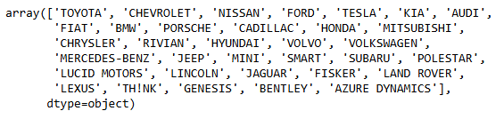
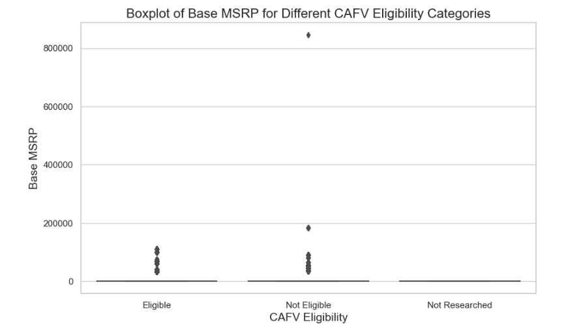
Univariate Analysis :
The provided dataset seems to have some outliers . Where the Eligible EV and Non Eligible EV are assigned with base price as 0 . There they were removed in the first place and the analytics was proceeded after the removal of the outliers . The below boxplot depicts the outliers identification .
The above listed array of names are the names of the company that are involved in development of Electric vehicles in the United States .These company have developed Electric Vehicles and they have been categorized under CAFV(Clean Alternative Fuel Vehicle ) Eligibility and each of the models have their base prices for under each category .

Slide 6
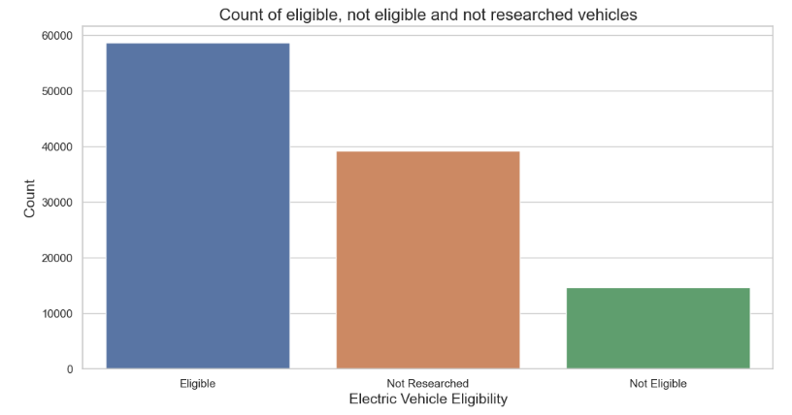
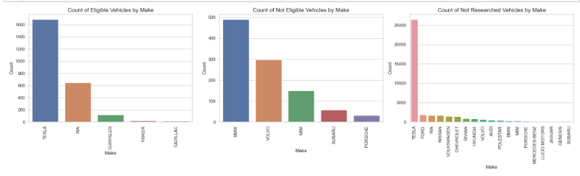
The Bar plot on the side depicts the count of EV’s based on the eligibility . From the visualization we can understand that Eligible EV vehicles are on the highest count followed by not researched and not eligible
The Bar plot below show the count of EV produced by various company’s based on the eligibility . From the analytics we can understand that ‘TESLA’ seems to have the maximum EV’s with Eligible ,Not Eligible and Not Researched status

Slide 7
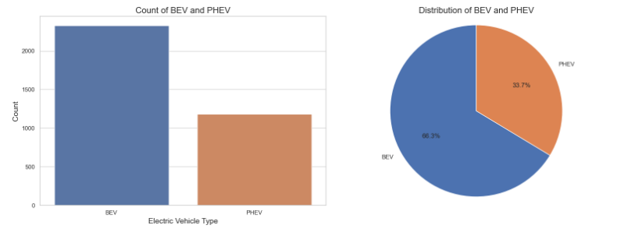
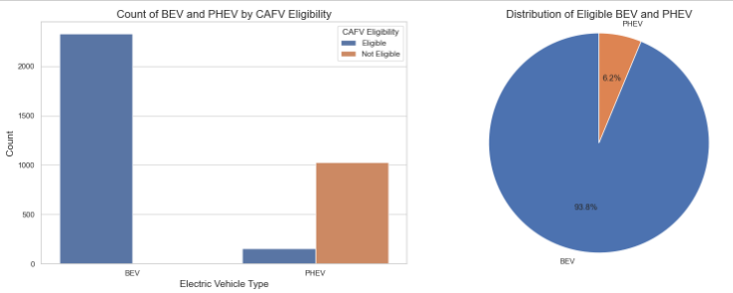
The visualizations on the side shows the distribution of the EV’s in terms of their classification as BEV (Battery Electric Vehicle) and PHEV (Plug-in Hybrid Electric Vehicle) under all the eligibility Categories . From the plots we can understand that the preference of BEV (battery electric vehicle ) is higher than PHEV (plug-in hybrid electric vehicle ) in terms of count .
# bivariate analysis :
From the plots we can understand that the preference of BEV (battery electric vehicle ) is higher than PHEV (plug-in hybrid electric vehicle ) in terms of count based on their eligibility classification . Here the count of Eligible BEV vehicles is high than that of PHEV the count of non eligible PHEV vehicles is high were as the non eligible BEV’s doesn’t seem to exist .

Slide 8
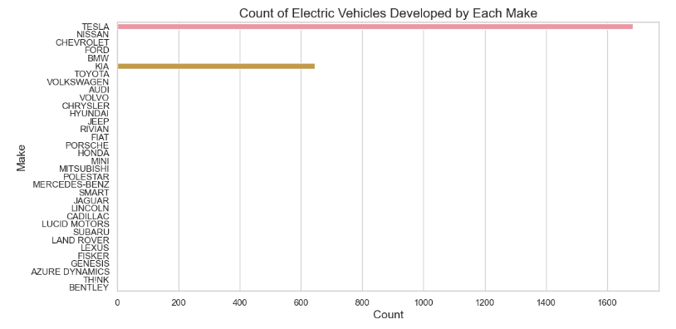
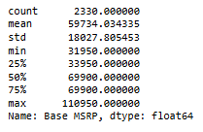
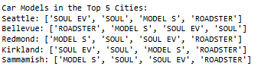

While considering the Battery Electric Vehicles the are only 2330 eligible BEV’s and when considering the base MSRP of the BEV’s the minimum price starts at 31950.00 and the top most or the maximum price is of 110950.00 .
The top models of BEV by count belongs to TESLA and KIA .
The above list is the list of the top 5 city with the maximum count of the BEV’s and the top most models that constitute that count .

Slide 9
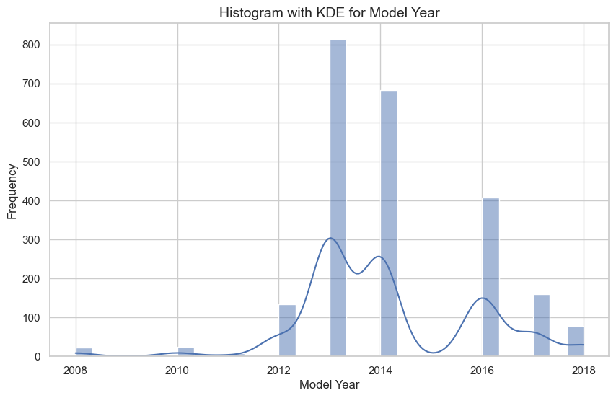
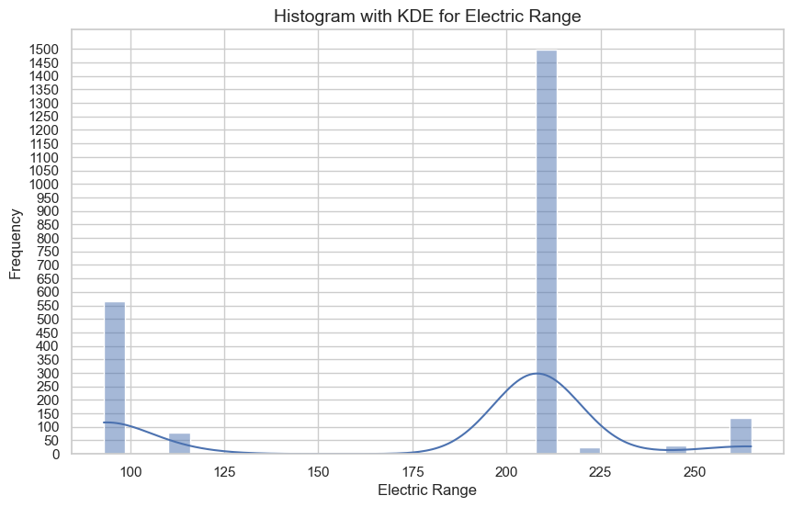
From the visualization beside we can read that 2013 model seems to have the maximum count in terms of sales and in terms of market buyers. There seems to be a downfalls for the 2015 models . 2008 and 2010 models seem to have low acceptance among customers .
The Histogram beside shows the Electric range of various BEV’s that are eligible .

Slide 10
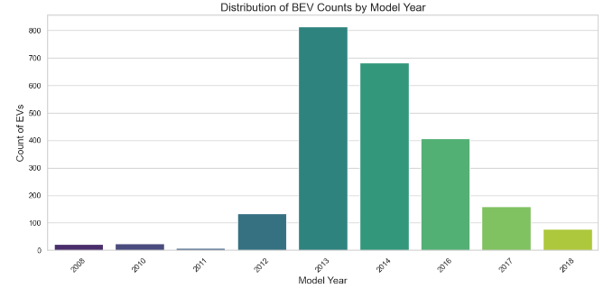
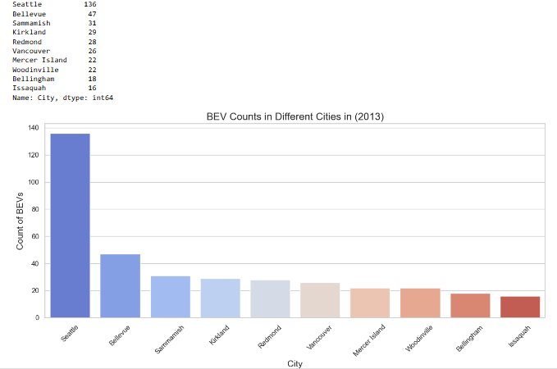
The count of the 2013 model seems to be high and highly accepted among the customers and the 2011 models seems to be the least .
Since the 2013 model seems to be on the highest sales the model count seems to be high in cities like Seattle, Bellevue , Sammamish , Kirkland , etc and the visualization shows the top 10 cities with the highest count of the 2013 model .

Slide 11

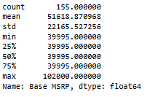
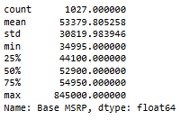
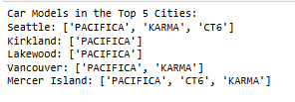

The Stats show that PHEV’s have both Eligible and Not Eligible vehicles and the count of the Not eligible vehicles seems to be high than that of the eligible PHEV’s .
From the Base MSRP stats for eligible PHEV’s the min price is 39995 and the max price is 102000 and when compared with the not eligible PHEV’s it min price is 34995 and the max price is 845000 .
The count of eligible PHEV’s seems to be high in the top 5 cities given beside and the top models of the eligible cars are mentioned too .
The count of not eligible PHEV’s seems to be high in the top 5 cities given beside and the top models of the not eligible cars are mentioned too .

Slide 12
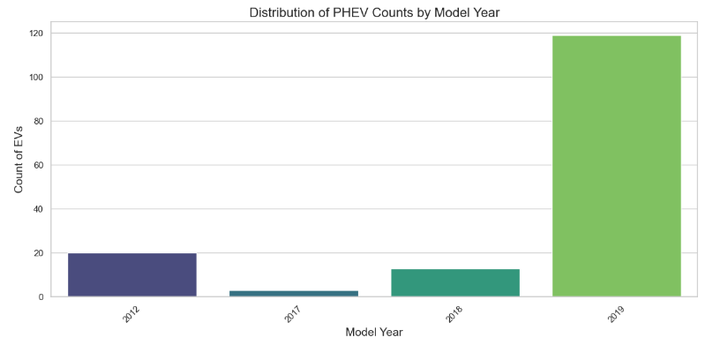
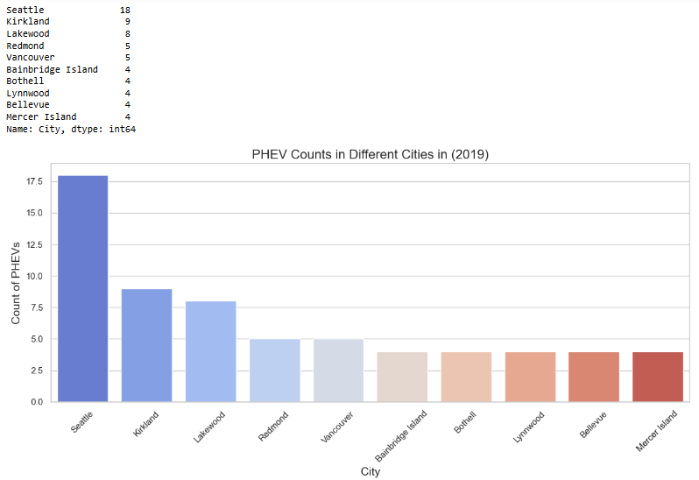
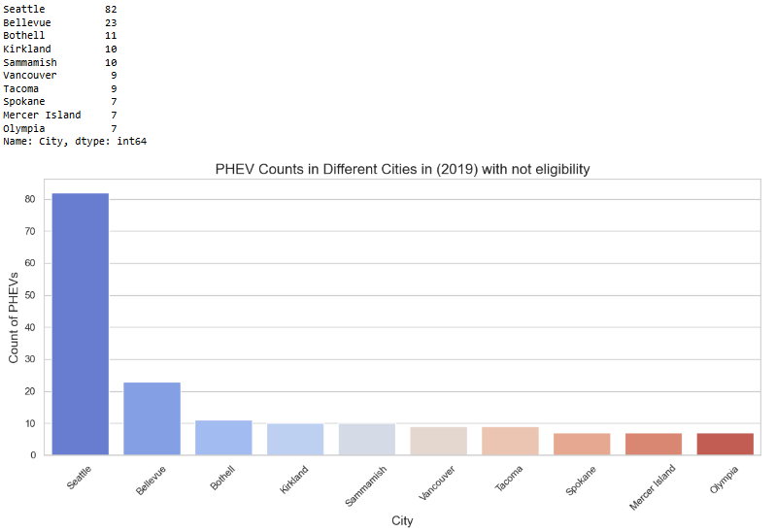
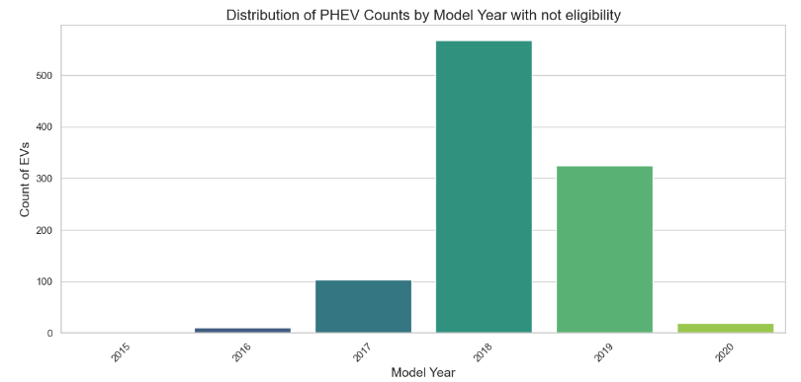
The PHEV eligible model count seems to be high of 2019 model and the cities with the top count of the 2019 model is given beside using a count plot . The city with the top count is Seattle with a count of 18 .
The PHEV not eligible model count seems to be high of 2018 model and the cities with the top count of the 2018 model is given beside using a count plot . The city with the top count is Seattle with a count of 82 .

Slide 13
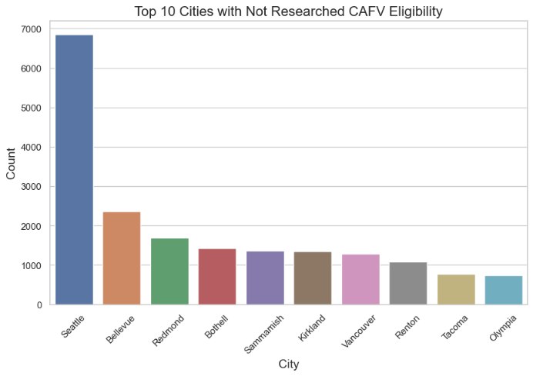
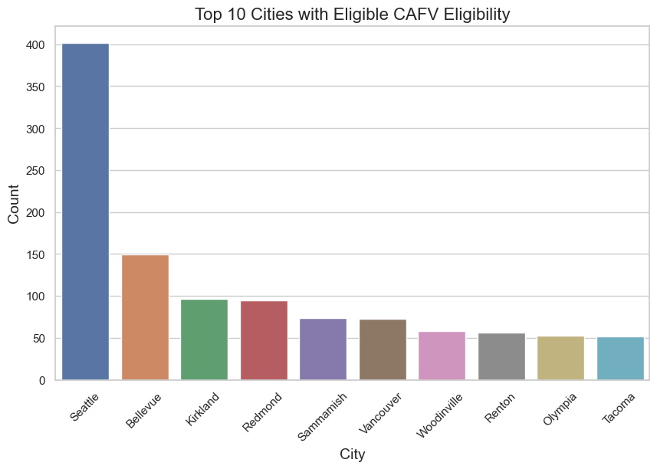
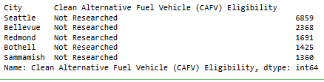
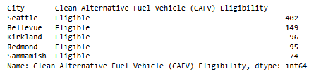
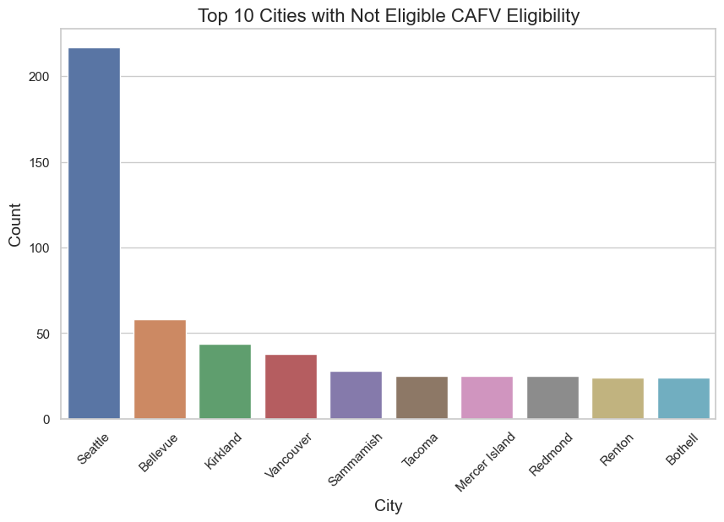
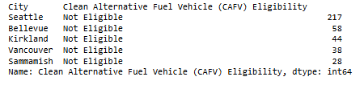
Bi-variate Analysis :

Slide 14
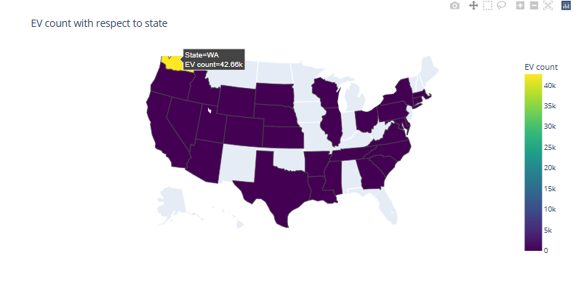
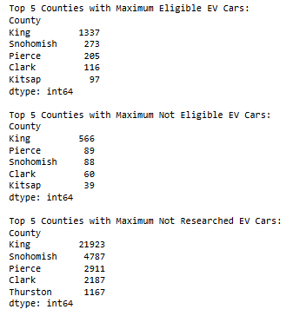
The choropleth plot shows the distribution of EV counts with respect to each state in United States . It is a interactive plot and it helps in understanding how in total the acceptance of Electric Vehicles is present in each state in the US .

Slide 15
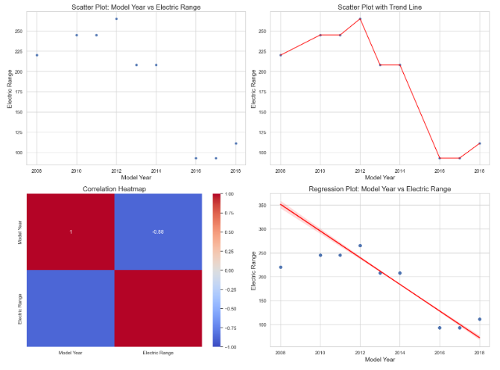
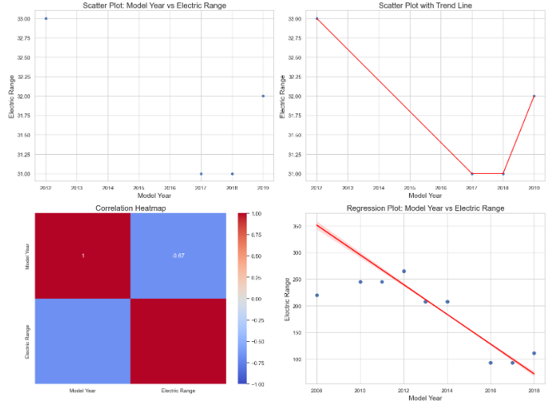
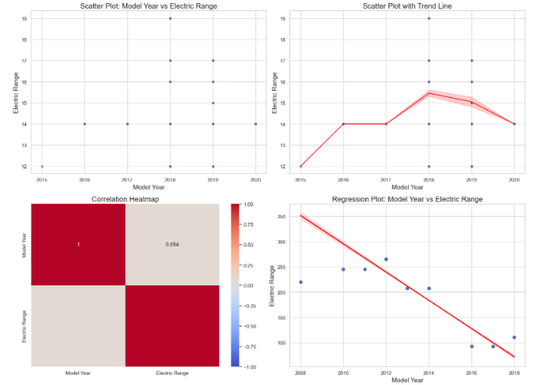
The scatterplot ,lineplot , Heatplot and the Regplot plotted above for each case of eligible and not eligible BEV and PHEV state that there is no correlation between the Model Year of electric vehicles and the Electric Range . From the heatmap and the regression plot there is a negative correlation between the Model year and Electric Range .

Slide 16
Conclusion :
Through this project, we were able to derive meaningful analytics and insights on electric vehicle (EV) registrations in Washington state, specifically focusing on Battery Electric Vehicles (BEVs) and Plug-in Hybrid Electric Vehicles (PHEVs). We identified how these vehicle types are distributed across different cities, providing a clear picture of EV adoption trends. The project helped in understanding the key areas where electric vehicles are gaining momentum and highlighted the growing importance of sustainable transportation. This analysis can be leveraged by policymakers, businesses, and the general public to further accelerate the transition to green energy in specific regions.
Challenges :
Data Quality and Outliers: The dataset had several outliers that needed to be pre-processed and handled before analysis, which proved to be a crucial step in maintaining data integrity.
City-wise Distribution Insights: Extracting meaningful insights from the dataset required feature extraction and transformation to analyze city-wise EV adoption effectively.
Data Transformation: Some columns required transformation to standardize values, especially with city names and vehicle types, to ensure accurate visualization and analytics.
Ensuring Consistency in Data: The quality and consistency of the dataset had to be maintained, as some records were incomplete or required imputation for smooth analysis.

Slide 17


Slide 18

THANK YOU

